Slide 1
Ash Inventory Project Update
David Showalter
Feb. 9, 2023

Slide 2
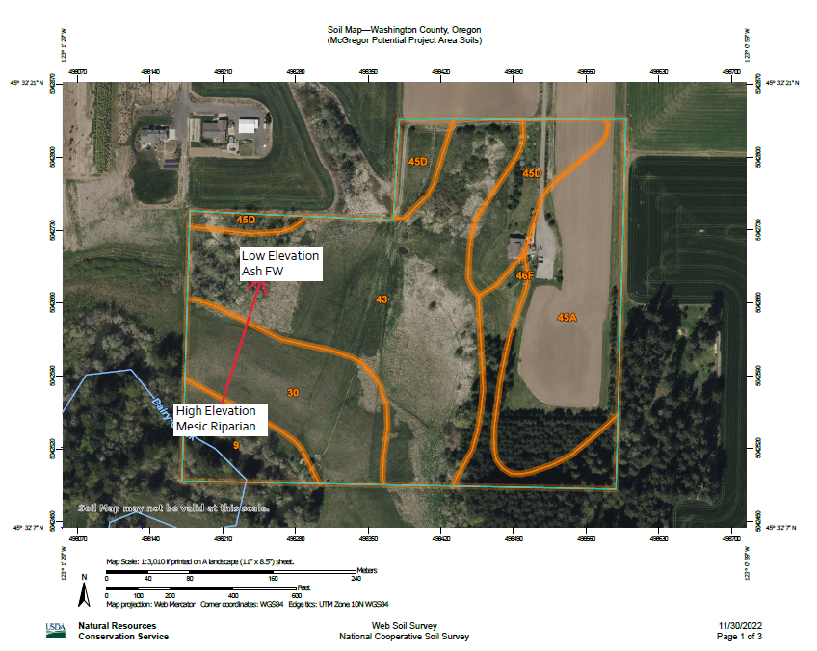
Stand Characterization
Stands need to be defined
Area with relatively homogeneous composition
Management unit
Hydrology
Datasheet created
Conroy TCWSD Statement of Need

Slide 3
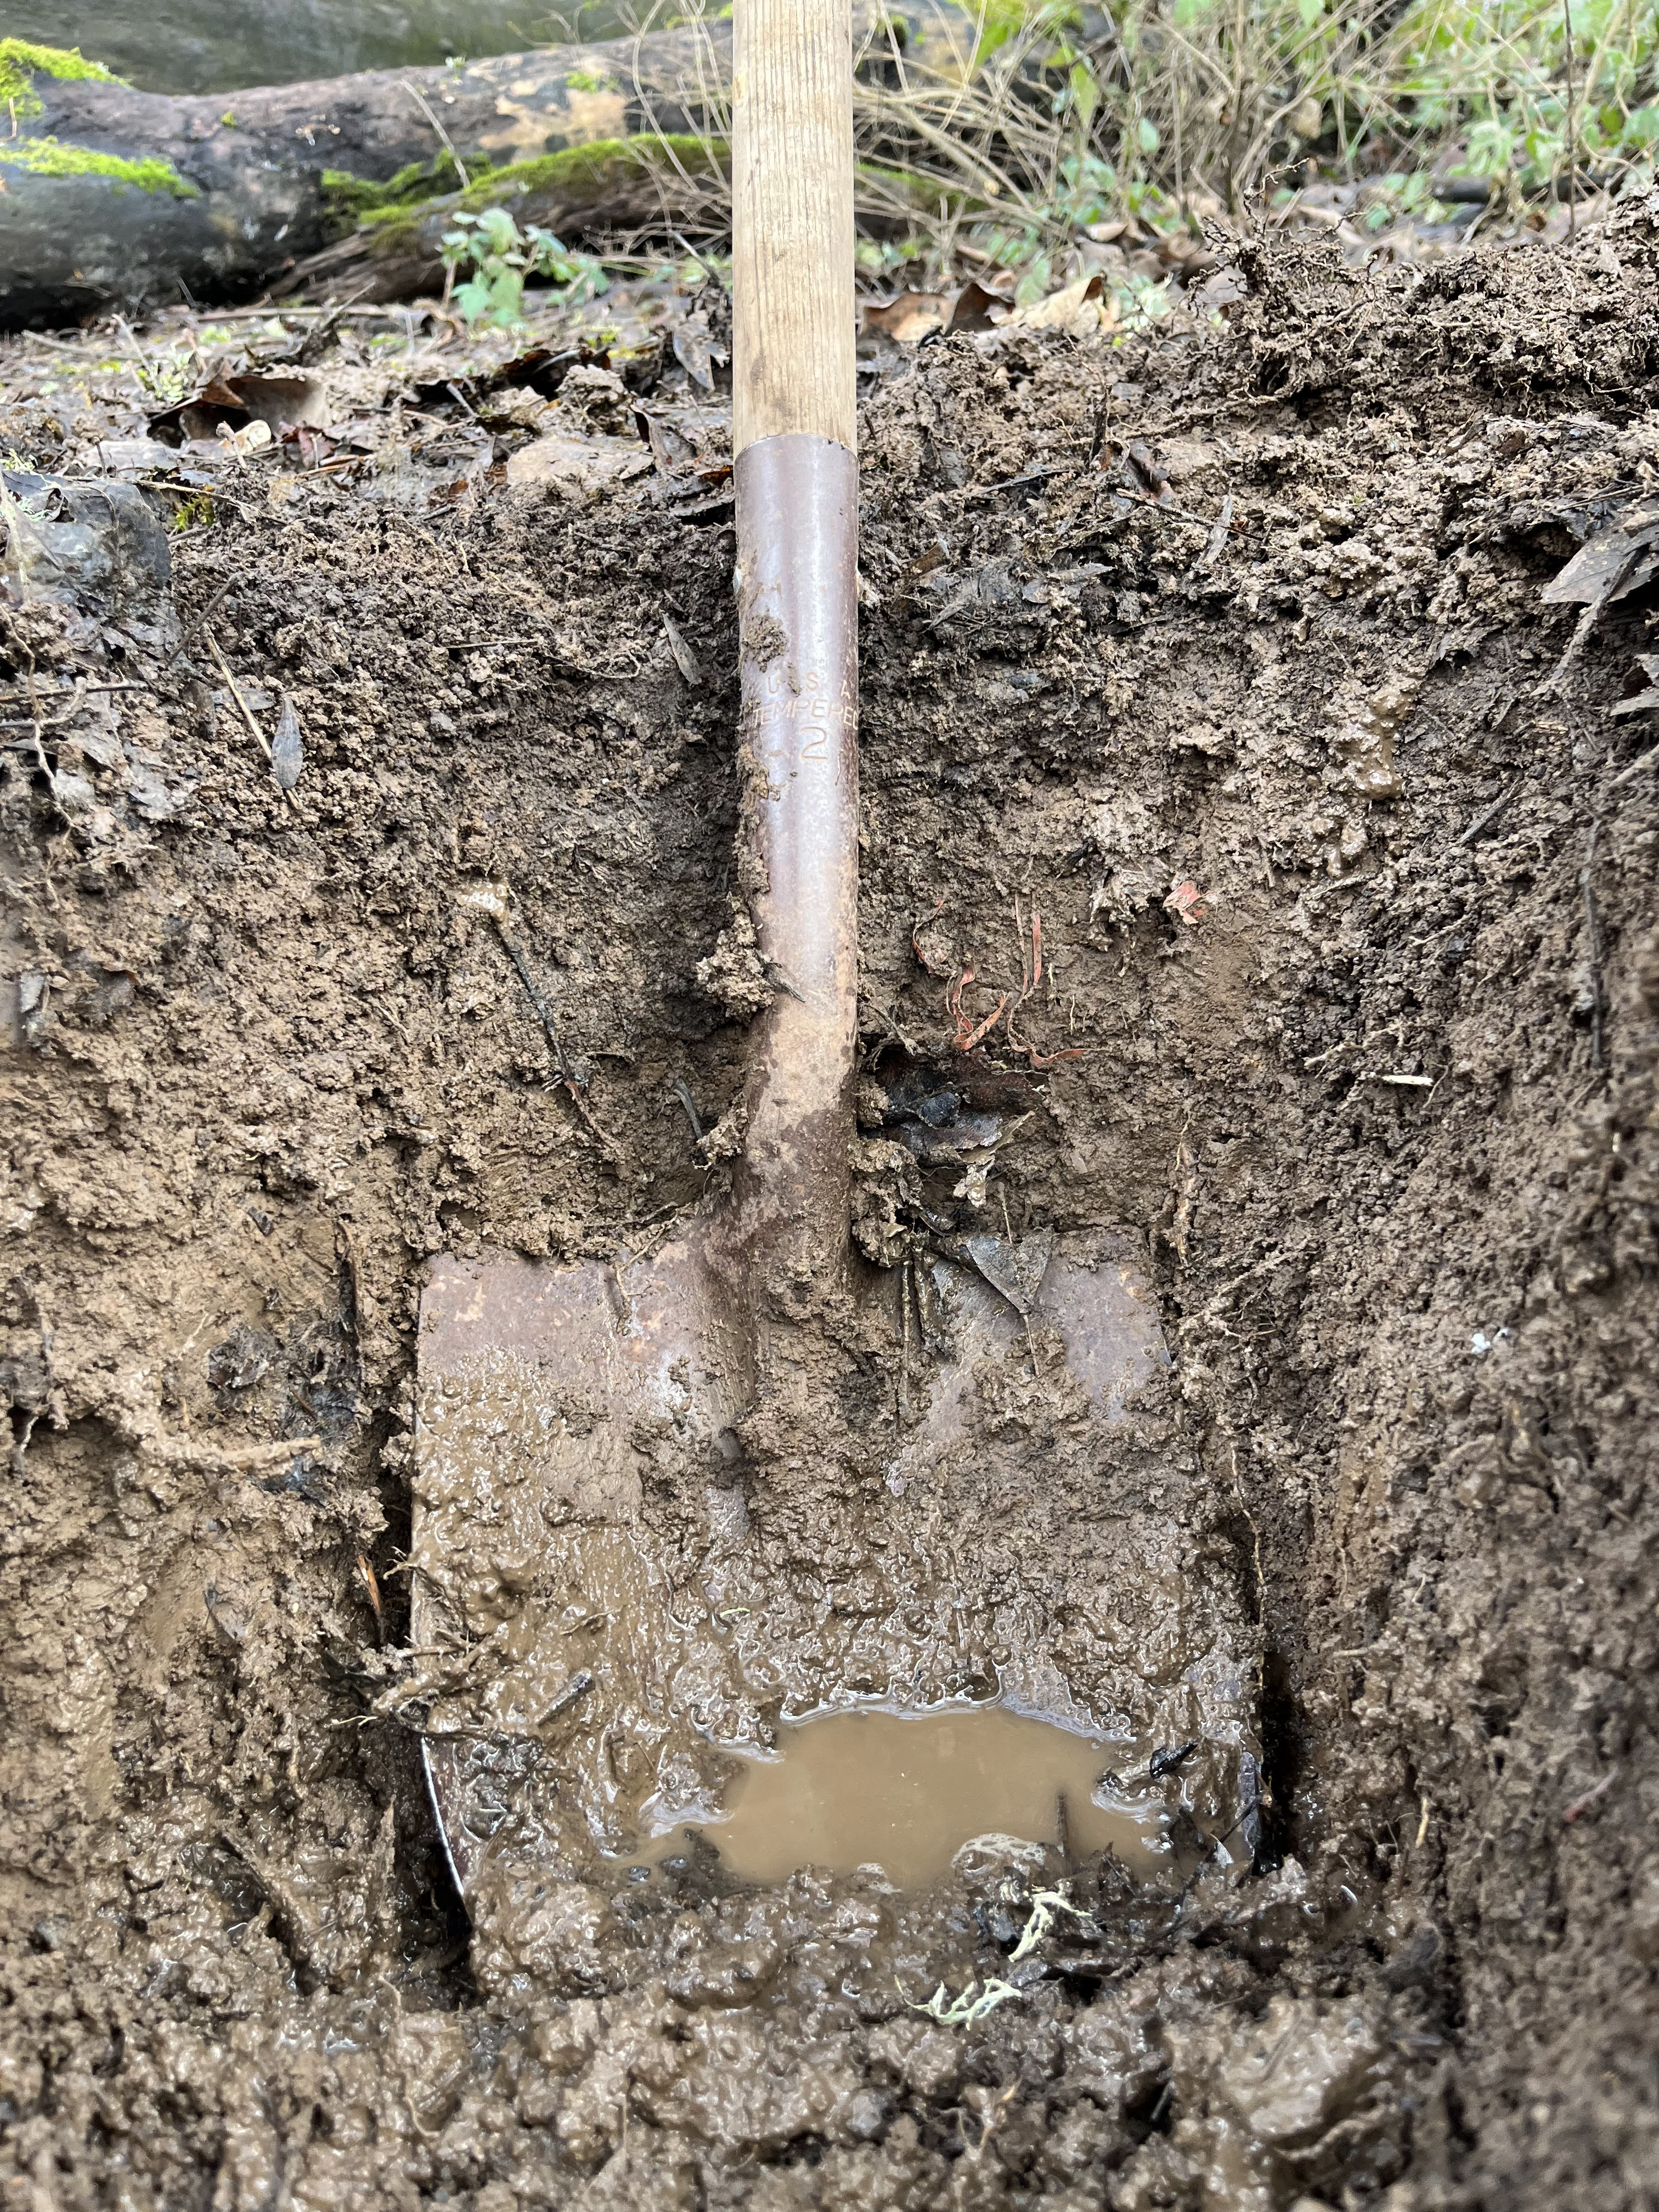
Soil mottling as indicator for hydrology
~2ft pit should be sufficient
Would not expect Oregon oaks in areas where mottling <4in (Prive)
Needs method refinement and pictoral guide

Slide 4
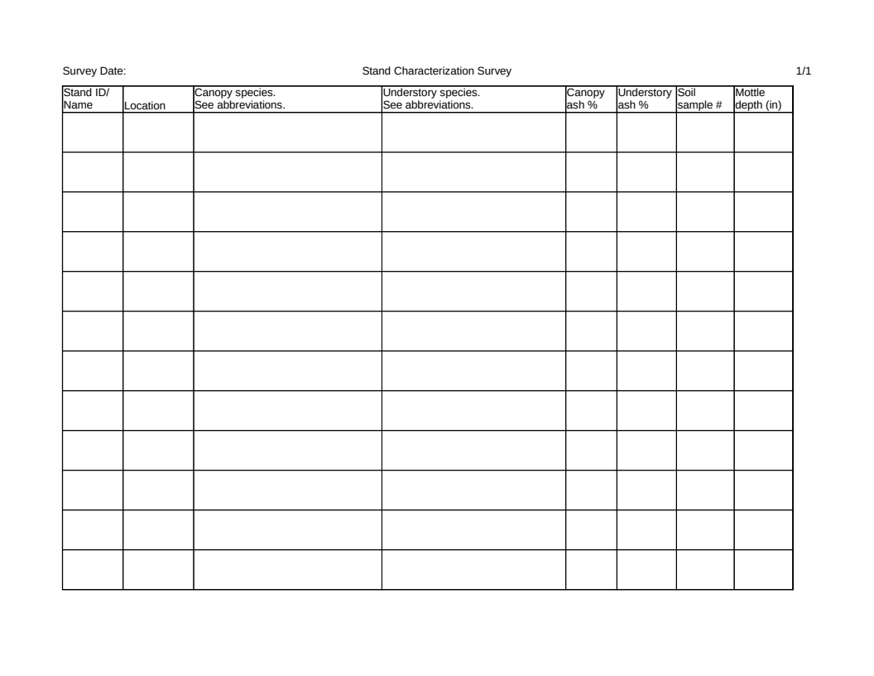
Stand Characterization Datasheet
Will need to provide instruction for selecting sampling locations to define relevant hydrological boundaries

Slide 5
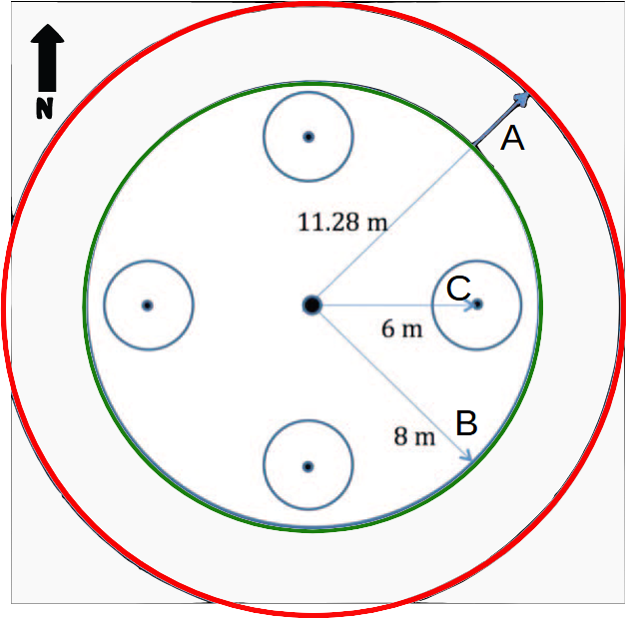
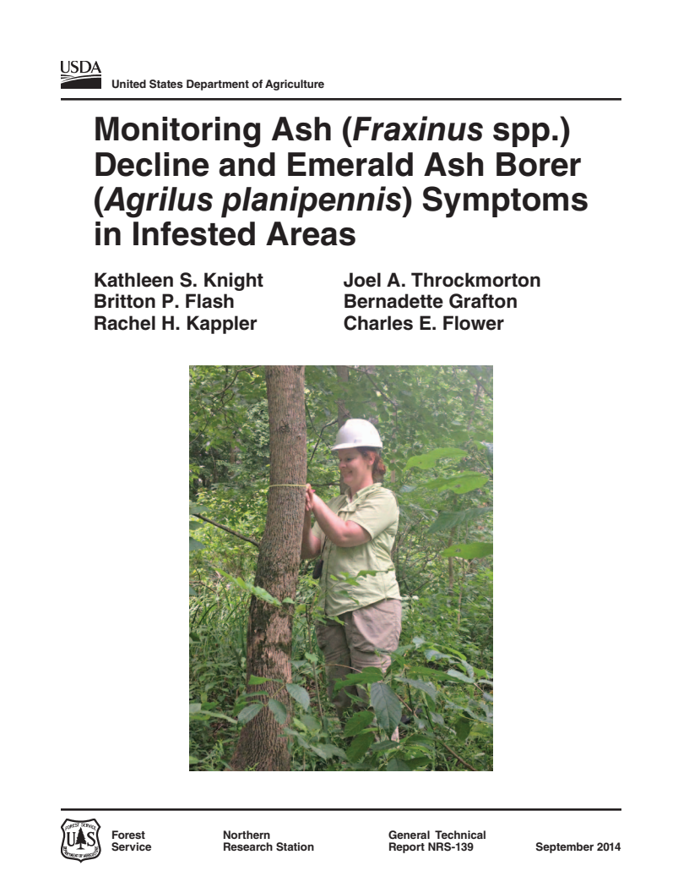
Inventory Plot Design
Recommending 3 plots per stand
Nested plots
A Large trees
B Medium
C Seedlings
Knight et al 2014 USFS GTR-NRS 139

Slide 6
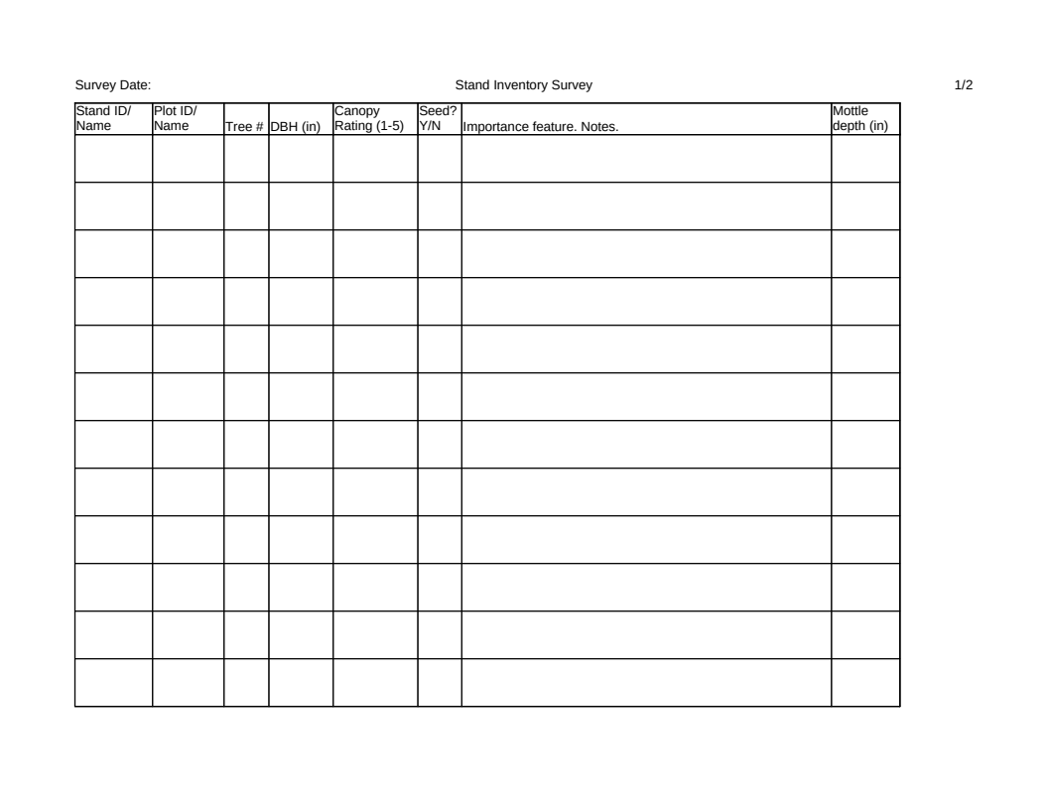
Tree inventory (large and medium)

Slide 7
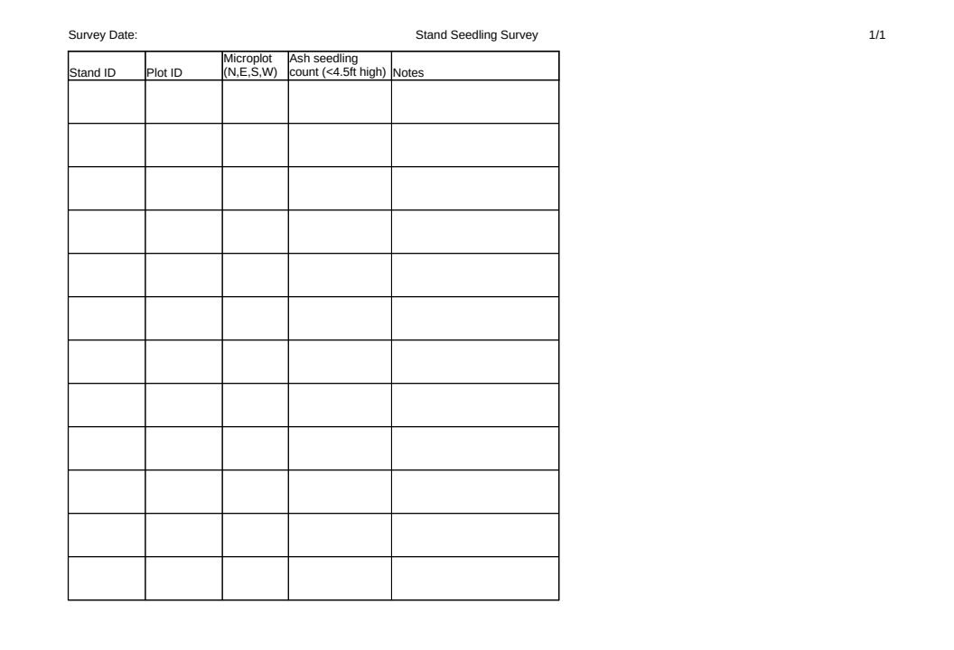
Seedling/ sapling inventory

Slide 8
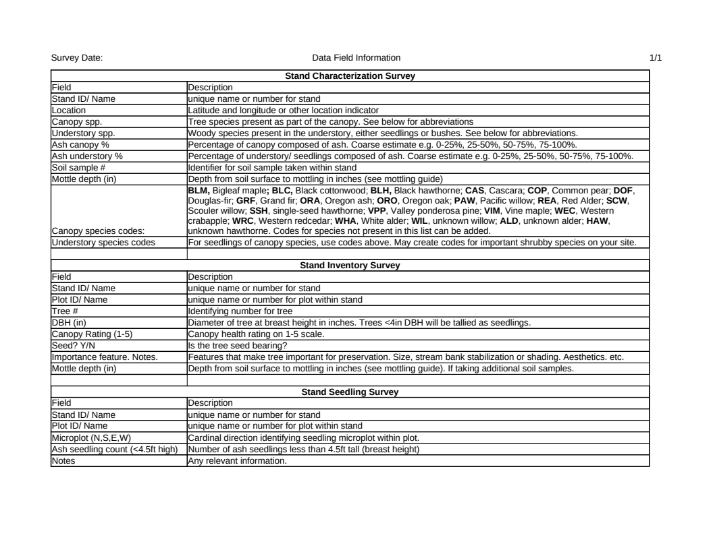
Datasheets

Slide 9
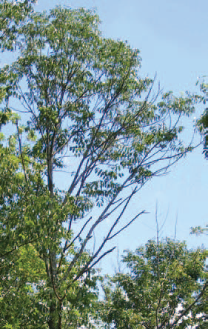
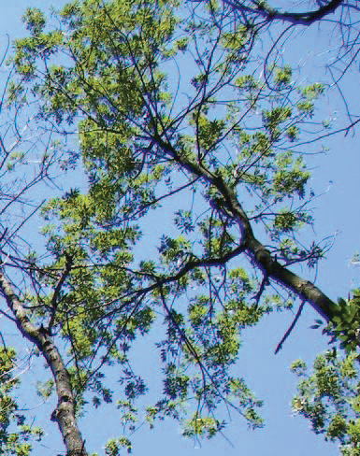
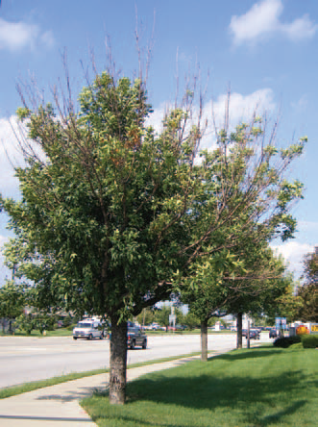
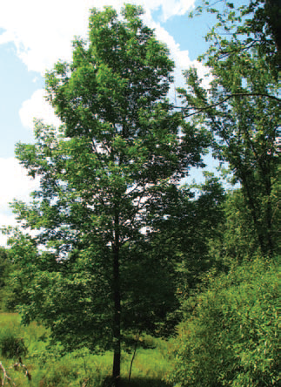
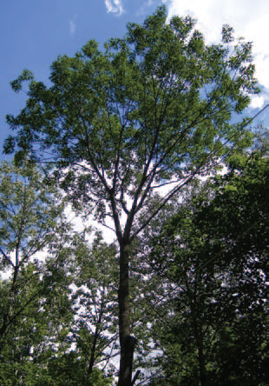
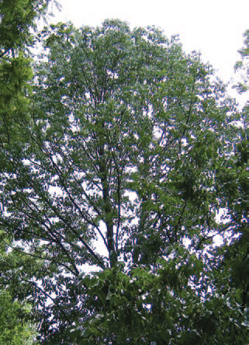
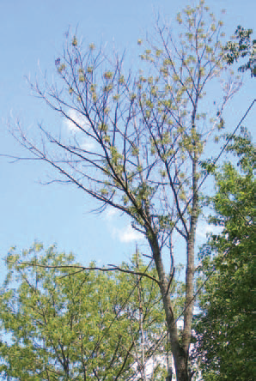
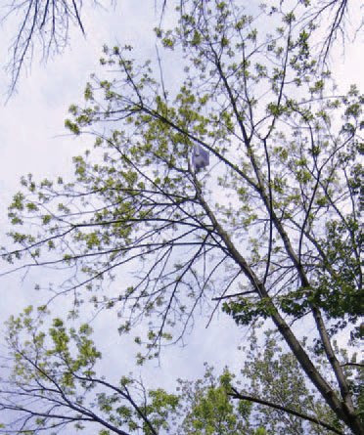
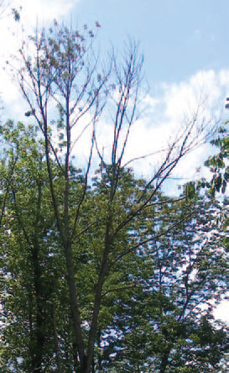
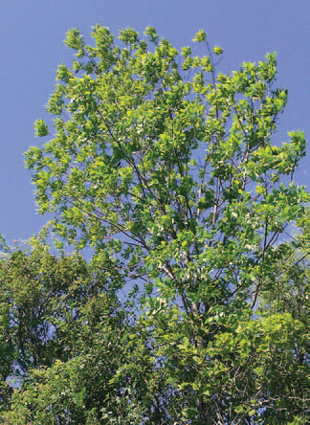
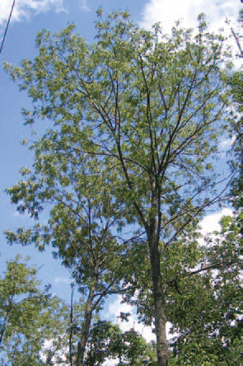
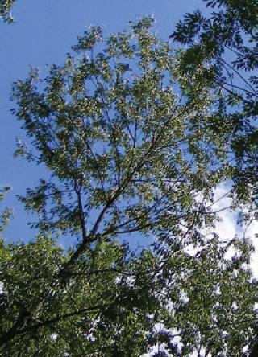
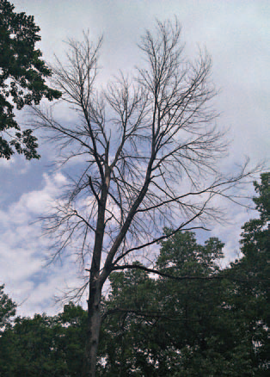
Canopy Rating
3
1
4
2
5
Knight et al 2014 USFS GTR-NRS 139

Slide 10
Next Steps
Get boots dirty
Soil pit testing
WDNR permit
Private landowner connections

